Slide 1
Computer Network (CS3002)
Spring Semester (2021-2022)
Dr. Judhistir Mahapatro
Department of Computer Science and Engineering
National Institute of Technology Rourkela

Slide 2
The Medium Access Control Sublayer

Slide 3
PROTOCOL ARCHITECTURE
Application
Presentation
Upper Layer Protocols
Session
Transport
Network
LLC
Logical Link Control
Medium Access Control
Data Link
MAC
Physical
Physical
OSI Model

Slide 4
The MAC Sub-layer
The MAC sub-layer is responsible for framing, error-detection and controlling access to the LAN transmission medium.
The LLC is responsible for providing an interface to the higher layers, flow control and error correction.

Slide 5
The Channel Allocation Problem
How to allocate single shared, broadcast channel among several stations/users.
If no arbitration, several stations/users may transmit at the same time: COLLISIONS!
Static Channel Allocation in LANs and MANs
Dynamic Channel Allocation in LANs and MANs

Slide 6
Static Channel Allocation
Frequency Division Multiplexing (FDM)
  multiple flows transmit at different frequencies
  each flow gets a different frequency band
  problems
    if the number of flows N is constant
      N+1st flow must be denied
      < N flows = poor utilization
    even when number of flows is constant and matches N, the amount of data per flow is sure to vary
Time Division Multiplexing (TDM)
  each flow has its own time slot: same problem

Slide 7
Static Channel Allocation
Problem
  Might not be efficient if
    The number of users is large and continuously varying, or
    The traffic is extremely bursty
      The peak traffic to mean traffic ratio can be 1000:1

Slide 8
Dynamic Channel Allocation
1. Station Model
  The model consists of N independent stations, each generates frames for transmission.
  Once a frame has been generated,
    The station is blocked and does nothing until the frame has been successfully transmitted.
2. Single Channel
  A single channel is available for all communication.
  All stations can transmit on it and all can receive from it.
  Stations are assumed to be equally capable

Slide 9
Dynamic Channel Allocation
3. Collision Assumption
  If two frames are transmitted simultaneously, they overlap in time and the resulting signal is garbled. This event is called a collision.
  All station can detect collisions.
  A collided frame must be transmitted again later. There are no errors other than those generated by collisions.

Slide 10
Dynamic Channel Allocation, cont.
4.(a) Continuous Time
    Frame transmission can begin at any instant.
    There is no master clock dividing time into discrete intervals.
(b) Slotted Time
    Time is divided into discrete intervals (slots).
    Frame transmissions always begin at the start of a slot.

Slide 11
Dynamic Channel Allocation, cont.
5. (a) Carrier Sense
  Stations can tell if the channel is in use before trying to use it.
  If the channel is sensed as busy, no station will attempt to use it until it goes idle.
(b) No Carrier Sense
  Stations cannot sense the channel before trying to use it. They just go ahead and transmit.
  Only later can they determine whether the transmission was successful.

Slide 12
Multiple Access Protocols
ALOHA
Carrier Sense Multiple Access Protocols
Collision-Free Protocols
Limited-Contention Protocols
Wireless LAN Protocols

Slide 13
ALOHA
History
  Designed at the University of Hawaii to solve the channel allocation problem
  Connect users on remote islands to main computer in Honolulu, cable under Pacific Ocean not a solution
  For ground-based radio broadcasting
Categories
  Pure Aloha
  Slotted Aloha
    Time is divided into fixed-size slots
    Global time synchronization

Slide 14
Pure Aloha
Main idea
    Let users transmit whenever they have data to be sent, then central computer broadcasts the frame
Collision detection
    Directly
    Detect delay
      LAN: negligible
      Satellite: 270 msec
    Indirectly
    via ACK frame
Retransmission
  The sender waits a random amount of time to send again

Slide 15
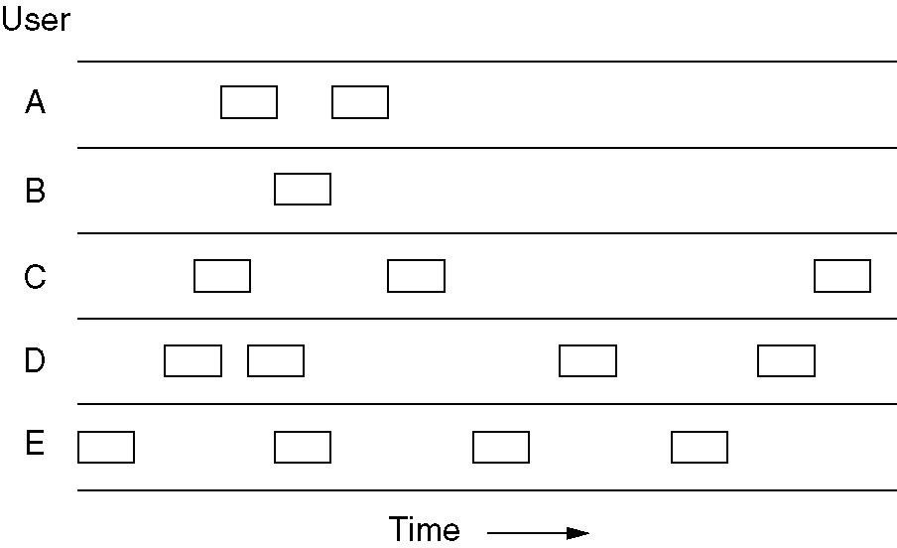
Illustration
In pure ALOHA, frames are transmitted at completely arbitrary times
  The throughput of ALOHA systems is maximized if the frame size is fixed (the same) for all frames

Slide 16
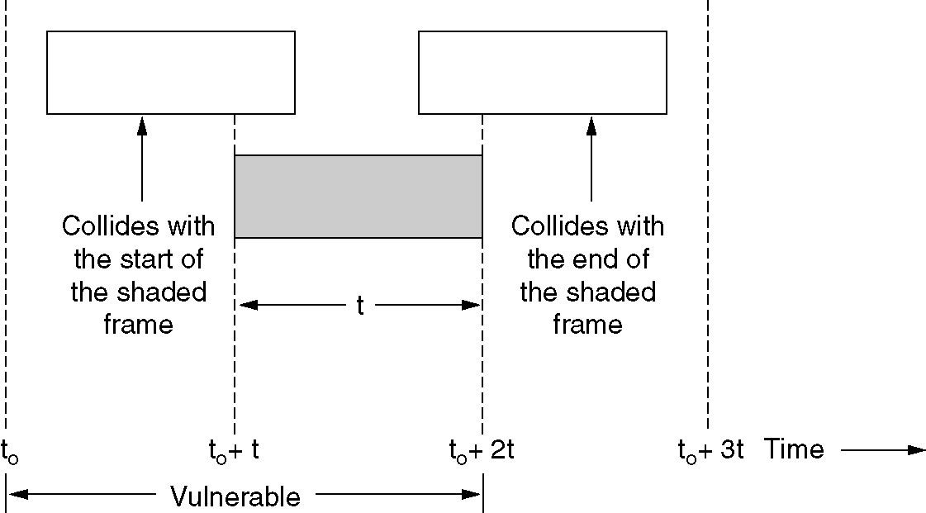
Vulnerable Period of A Frame

Slide 17
Performance
Throughput
  t/T
    T: The total amount of time
    t: The total amount of time that is used to transmit frame without collision
Assumption
  The number of stations is infinite
  The frame size is fixed
  The overall traffic (frame) incoming rate follows a Poisson distribution with rate G (frames per frame time)

Slide 18
Performance
Frame time denote the amount of time needed to transmit the standard, fixed-length frame.
New frames generated by the stations by a Poisson distribution with a mean of N frames per frame time.
If N > 1, generating frames at a higher rate than the channel can handle, and nearly every frame will suffer collision.
For reasonable throughput, 0<N<1.

Slide 19
Performance
Stations also generate retransmissions of the frames that previously suffered collisions.
Let further assume that old and new frames combined are well modeled by a Poison Distribution, with mean of G frames per frame time.
Clearly, G>=N.

Slide 20
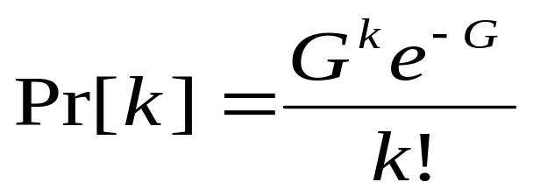
Performance
Throughput, S = GP₀ where, P₀ is the probability that a frame does not suffer collision
The probability that k frames are generated during a frame time is given by the Poisson distribution
P_{k} or

Slide 21
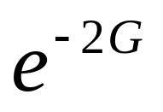
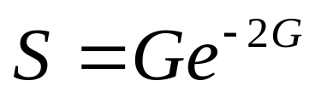
Performance
The probability that no frame is generated during the vulnerable period (two frames) is
The throughput of pure Aloha is
The maximum throughput is S=1/(2e) or about 0.184

Slide 22
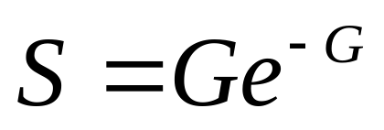
Slotted Aloha
Time is divided into fixed-size slots
Global time synchronization is required
Throughput
The maximum throughput is
  S =1/e or about 0.368

Slide 23
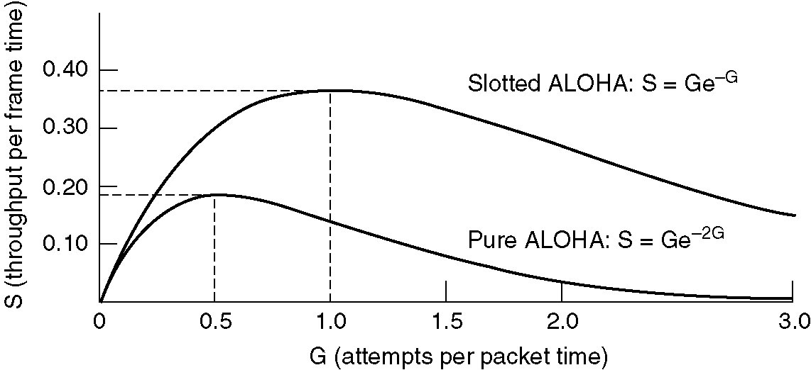
Throughput of Aloha Systems

Slide 24
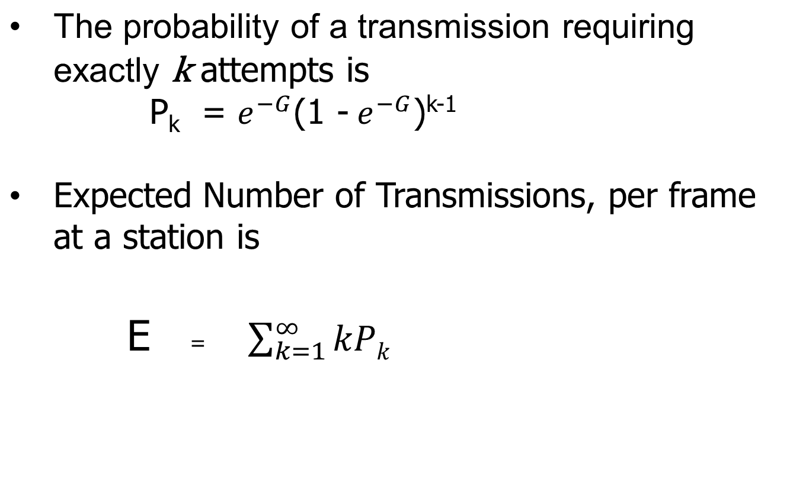


Exponential Dependence of E upon G

Slide 25
Carrier Sense Multiple Access Protocols
Problem of Aloha system
    A station does not consider what the others are doing
Key idea of CSMA
    A station can detect what other stations are doing and can then adapt its behavior accordingly

Slide 26
Categories of CSMA
1-Persistent
Nonpersistent
p-persistent

Slide 27
1-Persistent
A station that has a frame to send shall keep listening to (sensing) the channel
If the channel is busy, the station will be waiting till the channel becomes idle.
If the channel is idle, the station will transmit the frame.
  If collision occurs, the station waits a random amount of time and starts all over again.

Slide 28
Nonpersistent
A station shall listen to (sense) the channel at the moment that it has a frame to send
If the channel is busy, then the station will
    Stop sensing
    Wait for a random amount of time to sense again
If the channel is idle, then the station will send the frame

Slide 29
p-Persistence
Assumption: slotted channel
A station shall listen to (sense) the channel at the moment that it has a frame to send
If the channel is busy, then the station will
  Waits until the next slot.

Slide 30
p-Persistence
If the channel is idle, then the station will send the frame with
  a probability p,
  a probability q = (1-p) it defers until next slot
    If that slot is also idle, transmits and defers with p and q, respectively.
    Process is repeated until either the frame has been transmitted or another station has begun transmitting.
    If another station has begun, then it waits for random amount time and starts it again.

Slide 31
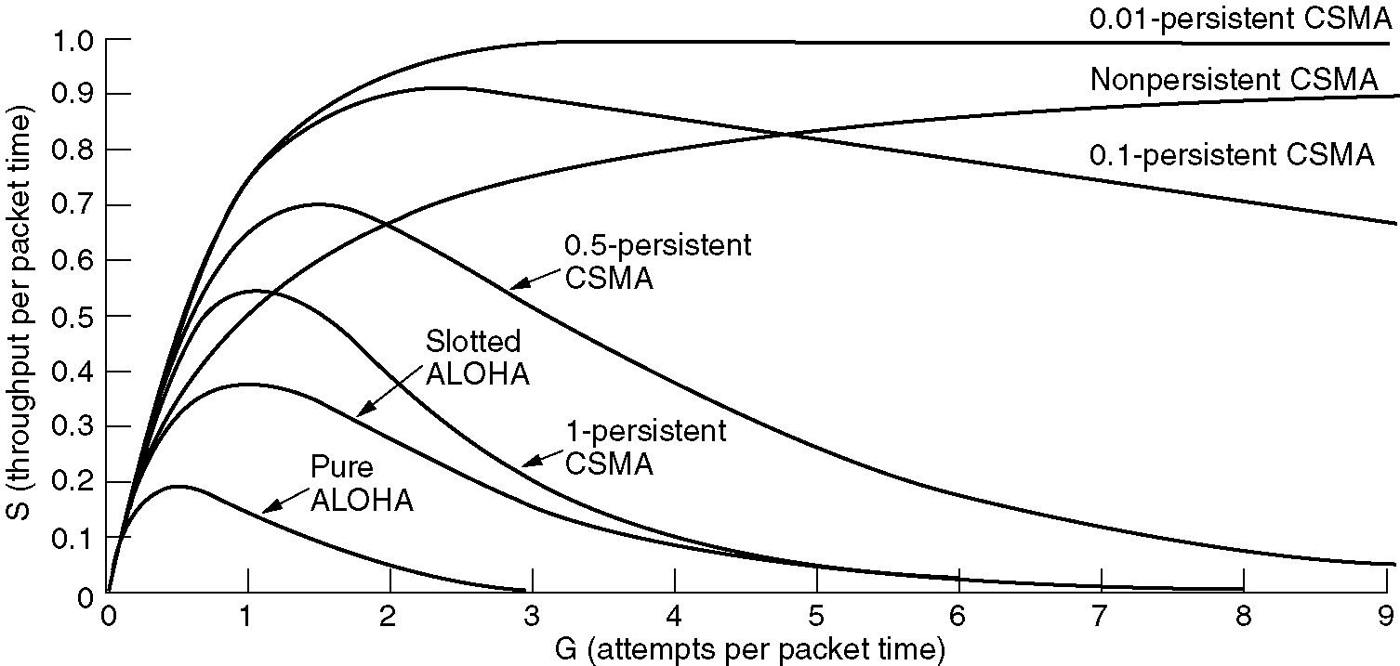
Performance of CSMA

Slide 32
Reference
Computer Networks, Fifth Edition by Andrew Tanenbaum and David Wetherall, Pearson Education-Prentice Hall, 2011

